Slide 1


Max Wang (u5584091)
Felicity Lee (u5558958)
Fangqin Chen (u5552738)
Notes:
Why would we make a game that doesn’t appeal to ourselves?

Slide 2

The Problem.
How could we make a boring old card game appeal to us?
© 2014 COMP1140 Assignment #2 Max Wang (u5584091) Felicity Lee (u5558958) Fangqin Chen (u5552738)
Notes:
We had basic ideas
Still retain Renier game rules and style
Something that was more modern and enjoyable than classic renier
Clean and simple interface that was interactive

Slide 3
The Key Elements
To tackle this problem, we decided to consult the Google Play store.
© 2014 COMP1140 Assignment #2 Max Wang (u5584091) Felicity Lee (u5558958) Fangqin Chen (u5552738)

Slide 4
The Key Elements
To tackle this problem, we decided to consult the Google Play store.
A common theme between all of the most popular applications were:
Aesthetics
Customizability
Competitivity
© 2014 COMP1140 Assignment #2 Max Wang (u5584091) Felicity Lee (u5558958) Fangqin Chen (u5552738)
Notes:
T
Everyone wants to switch it around once in a while.
Obviously, for a game like Renier, there is not much to be customized, but for everything that could (number of royals), number of deck cards.
BUT HOW COULD WE DO THIS?!??! OMG!?

Slide 5
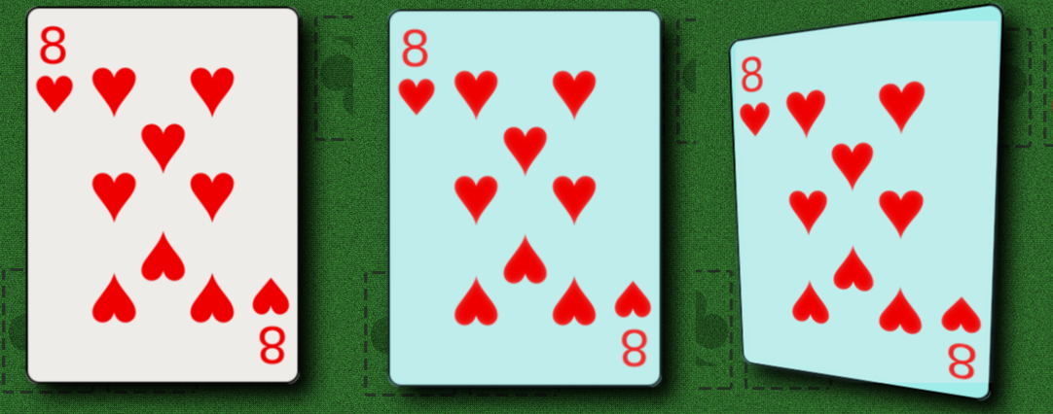
Aesthetics
The visuals of our game was one of the main focuses.
© 2014 COMP1140 Assignment #2 Max Wang (u5584091) Felicity Lee (u5558958) Fangqin Chen (u5552738)
Notes:
Went with a more minimalistic design for the cards so there wasn’t too much clutter on the screen
We wanted a game a person could just pick up and play, without the need to read long, tedious instruction manuals.
We also wanted a game which was as simple to play as possible.
Animations to make the game more smooth
Animation of card as it moves around and then snaps back when let go of
Glowing of card if able to move
Changing of mouse if hovering over a card

Slide 6
Customizability
A game that never changes is boring; nobody wants to play a game they can always win
© 2014 COMP1140 Assignment #2 Max Wang (u5584091) Felicity Lee (u5558958) Fangqin Chen (u5552738)
Notes:
he key to an enjoyable, and especially re-playable game is challenge. Nobody wants to play a game they can always win.
Allowed for the customization of the player’s experience through an opening screen which allowed for settings of the game to be changed.
We needed a game that provided an easy introduction to Renier, as well as progressive difficulty settings which allowed further enjoyment as the player accustomed themselves to the gameplay.

Slide 7
Customizability
A game that never changes is boring; nobody wants to play a game they can always win
To do this, we needed a customizable difficulty.
© 2014 COMP1140 Assignment #2 Max Wang (u5584091) Felicity Lee (u5558958) Fangqin Chen (u5552738)
Notes:
he key to an enjoyable, and especially re-playable game is challenge. Nobody wants to play a game they can always win.
Allowed for the customization of the player’s experience through an opening screen which allowed for settings of the game to be changed.
We needed a game that provided an easy introduction to Renier, as well as progressive difficulty settings which allowed further enjoyment as the player accustomed themselves to the gameplay.

Slide 8
Customizability
A game that never changes is boring; nobody wants to play a game they can always win
To do this, we needed a customizable difficulty.
This was done through an opening screen which allowed for various settings of the game to be changed
© 2014 COMP1140 Assignment #2 Max Wang (u5584091) Felicity Lee (u5558958) Fangqin Chen (u5552738)
Notes:
he key to an enjoyable, and especially re-playable game is challenge. Nobody wants to play a game they can always win.
Allowed for the customization of the player’s experience through an opening screen which allowed for settings of the game to be changed.
We needed a game that provided an easy introduction to Renier, as well as progressive difficulty settings which allowed further enjoyment as the player accustomed themselves to the gameplay.

Slide 9

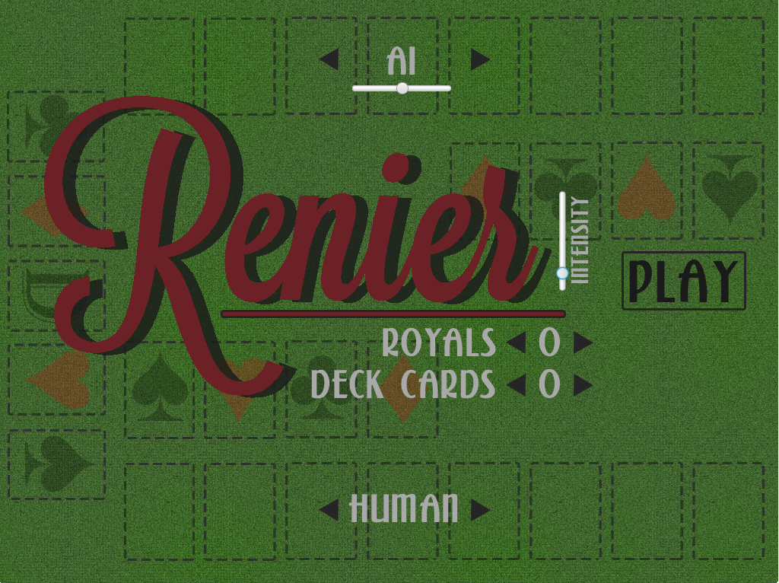
Notes:
he key to an enjoyable, and especially re-playable game is challenge. Nobody wants to play a game they can always win.
To do this, we needed a customizable difficulty.
We needed a game that provided an easy introduction to Renier, as well as progressive difficulty settings which allowed further enjoyment as the player accustomed themselves to the gameplay.
Note the intensity slider.

Slide 10
Customizability
A game that never changes is boring; nobody wants to play a game they can always win
To do this, we needed a customizable difficulty.
This was done through an opening screen which allowed for various settings of the game to be changed
We added an Intensity slider to make the game more engaging.
© 2014 COMP1140 Assignment #2 Max Wang (u5584091) Felicity Lee (u5558958) Fangqin Chen (u5552738)
Notes:
We felt that a game needed to be more immersive, so we added an intensity slider.
Unfortunately, we did not observe any increase in intensity or immersion when we set the slider to maximum. This was disappointing.

Slide 11
Competitivity
A key component to any game is competition
© 2014 COMP1140 Assignment #2 Max Wang (u5584091) Felicity Lee (u5558958) Fangqin Chen (u5552738)
Notes:
. A player wants to challenge their friends, to see who is better. To provide this, we needed to accommodate for Player vs Player games, as well as Player vs AI games.
For interest, we also added Ai vs AI
(sorry my bad jokes YOU TOLD ME TO)

Slide 12
Competitivity
A key component to any game is competition
A player wants to challenge their friends, and also (if they have no friends) challenge something!
© 2014 COMP1140 Assignment #2 Max Wang (u5584091) Felicity Lee (u5558958) Fangqin Chen (u5552738)
Notes:
. A player wants to challenge their friends, to see who is better. To provide this, we needed to accommodate for Player vs Player games, as well as Player vs AI games.
For interest, we also added Ai vs AI
(sorry my bad jokes YOU TOLD ME TO)

Slide 13
Competitivity
A key component to any game is competition
A player wants to challenge their friends and family, and if they have none, themselves.
Therefore, we had to create a decent AI that would provide this
© 2014 COMP1140 Assignment #2 Max Wang (u5584091) Felicity Lee (u5558958) Fangqin Chen (u5552738)
Notes:
. A player wants to challenge their friends, to see who is better. To provide this, we needed to accommodate for Player vs Player games, as well as Player vs AI games.
For interest, we also added Ai vs AI
(sorry my bad jokes YOU TOLD ME TO)

Slide 14
Artificial Intelligence
Our first implementation of AI was a simple heuristic.
© 2014 COMP1140 Assignment #2 Max Wang (u5584091) Felicity Lee (u5558958) Fangqin Chen (u5552738)
Notes:
In our initial implementation of the game, the AI was just a simple heuristic function, which started by counting the total value of each suit in the hand,
If any of them were greater than 20, our AI would start drawing from the suit’s pile, and start and continue playing the lowest possible card into the run
Otherwise it would draw from the pile which the value of cards in hand were the most in, and discard the suit of which the hand had the least value.
This resulted in an AI that although managed to get a decent score, it was still quite easy to win against, simply by waiting for it to start a new run
then ending the game as it could not possibly account for all possible factors.
This AI was also completely non-adjustable, as it relied on a heuristic that would be difficult to mould to different difficulty settings.

Slide 15
Artificial Intelligence
Our first implementation of AI was a simple heuristic.
Our next consideration was using a search tree, which we realised still had many limitations
© 2014 COMP1140 Assignment #2 Max Wang (u5584091) Felicity Lee (u5558958) Fangqin Chen (u5552738)
Notes:
Search Trees were to computationally complex.
With a draw and a play, There are about 40 different possible moves per turn.
Infeasible, as this limited depth to less than 5 moves.

Slide 16
Artificial Intelligence
Our first implementation of AI was a simple heuristic.
Our next consideration was using a search tree, which we realised still had many limitations
Finally, we settled on a basic implementation of Monte Carlo
© 2014 COMP1140 Assignment #2 Max Wang (u5584091) Felicity Lee (u5558958) Fangqin Chen (u5552738)
Notes:
The Monte Carlo method basically involves
For each possible move, however many games is played with both players playing random moves
The move with the highest number of wins is taken as the AI’s move
This allowed for an easily adjustable difficulty -> change the number of games is played per move

Slide 17
Artificial Intelligence
Our first implementation of AI was a simple heuristic.
Our next consideration was using a search tree, which we realised still had many limitations
Finally, we settled on a basic implementation of Monte Carlo
We realised that despite being better than a Search Tree, it was still sub-par.
© 2014 COMP1140 Assignment #2 Max Wang (u5584091) Felicity Lee (u5558958) Fangqin Chen (u5552738)
Notes:
However, we realised a fundamental flaw within the Monte-Carlo method – By playing completely
random games to test each move, it was highly likely that each of the four runs were always
Filled at the end of the game. As such, the AI is unable to recognise this that starting runs meant
Losing points.
To mitigate this, we added some heuristics to make sure the AI didn’t make completely stupid moves
Plays a card into run when a lower card is in hand
Starts a run with a card higher than 9

Slide 18
Uniqueness
Clearly, from the analysis of our research data, a game such as Renier was simply not good enough (to reach top app).
© 2014 COMP1140 Assignment #2 Max Wang (u5584091) Felicity Lee (u5558958) Fangqin Chen (u5552738)
Notes:
To set this apart from other classical card games, we needed to add unique gameplay elements.
We decided to create a game which combined the features of retro styled arcade games with generic “Hearts” typed game
Remember that intensity slider earlier? We turned that into a timer.
We implemented a lives system which punished the player for making a invalid move or taking too long to make a move.
To increase the stakes, we added a dominoes-effect, where the player’s screen blurs after losing a life.
This allowed the game to have a greater overall difficulty, making up for the limitations in our AI

Slide 19
Uniqueness
Clearly, from the analysis of our research data, a game such as Renier was simply not good enough (to reach top app).
We combined the features of a generic “Hearts” styled card game with a those of a retro styled arcade game.
© 2014 COMP1140 Assignment #2 Max Wang (u5584091) Felicity Lee (u5558958) Fangqin Chen (u5552738)
Notes:
To set this apart from other classical card games, we needed to add unique gameplay elements.
We decided to create a game which combined the features of retro styled arcade games with generic “Hearts” typed game
Remember that intensity slider earlier? We turned that into a timer.
We implemented a lives system which punished the player for making a invalid move or taking too long to make a move.
To increase the stakes, we added a dominoes-effect, where the player’s screen blurs after losing a life.
This allowed the game to have a greater overall difficulty, making up for the limitations in our AI

Slide 20
Uniqueness
Clearly, from the analysis of our research data, a game such as Renier was simply not good enough (to reach top app).
We combined the features of a generic “Hearts” styled card game with a those of a retro styled arcade game.
A lives system was added, to increase the difficulty.
© 2014 COMP1140 Assignment #2 Max Wang (u5584091) Felicity Lee (u5558958) Fangqin Chen (u5552738)
Notes:
To set this apart from other classical card games, we needed to add unique gameplay elements.
We decided to create a game which combined the features of retro styled arcade games with generic “Hearts” typed game
Remember that intensity slider earlier? We turned that into a timer.
We implemented a lives system which punished the player for making a invalid move or taking too long to make a move.
To increase the stakes, we added a dominoes-effect, where the player’s screen blurs after losing a life.
This allowed the game to have a greater overall difficulty, making up for the limitations in our AI

Slide 21
So…
What was the outcome of these features?
Max Wang (u5584091)
Felicity Lee (u5558958)
Fangqin Chen (u5552738)
Notes:
Give short demo of game.
Human vs Ai, human dies
75% AI vs 0% AI.

Slide 22
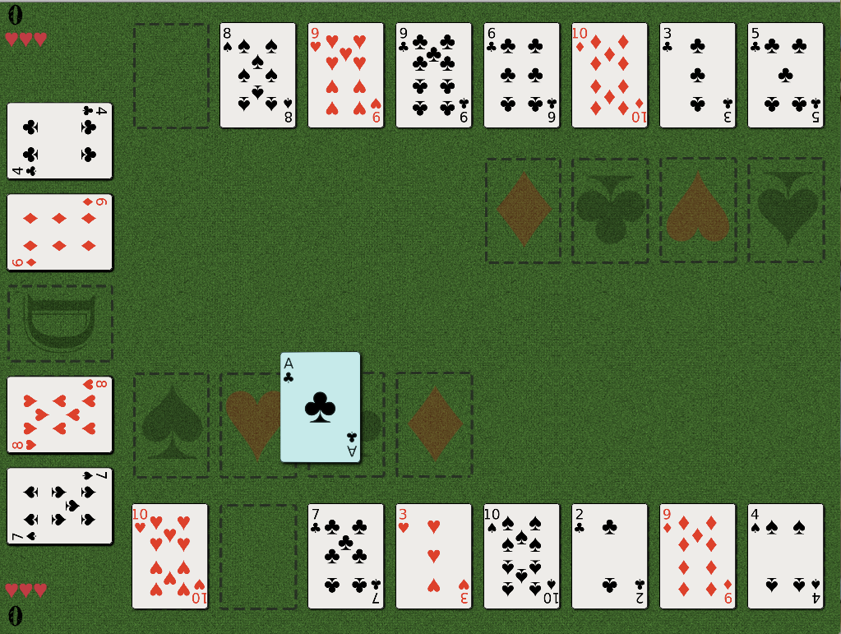
Animations make the game easier to learn.
Max Wang (u5584091)
Felicity Lee (u5558958)
Fangqin Chen (u5552738)
Notes:
Give short demo of game.
Human vs Ai, human dies
75% AI vs 0% AI.

Slide 23
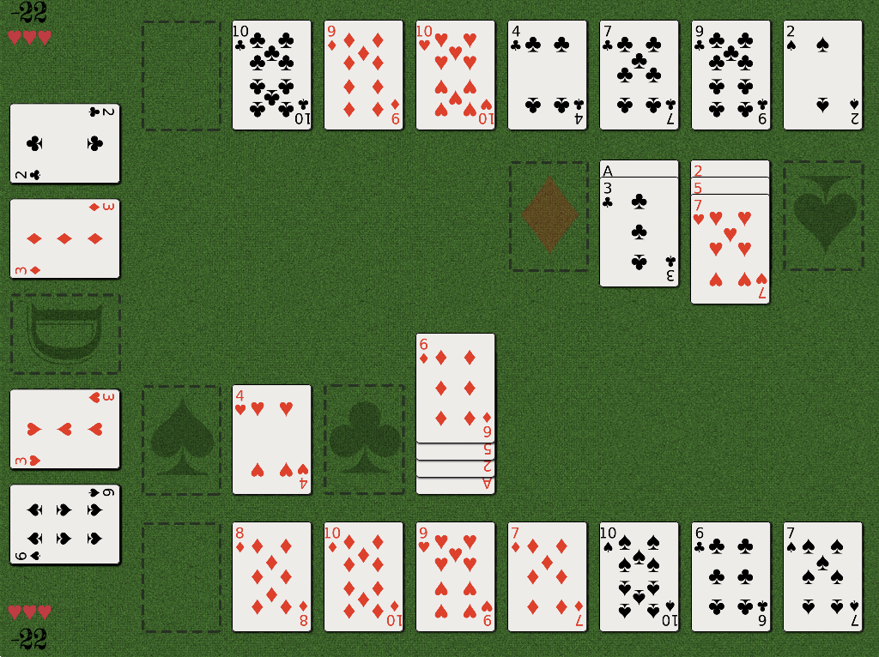
The UI is overall intuitive and easy to understand.
Max Wang (u5584091)
Felicity Lee (u5558958)
Fangqin Chen (u5552738)
Notes:
Give short demo of game.
Human vs Ai, human dies
75% AI vs 0% AI.

Slide 24
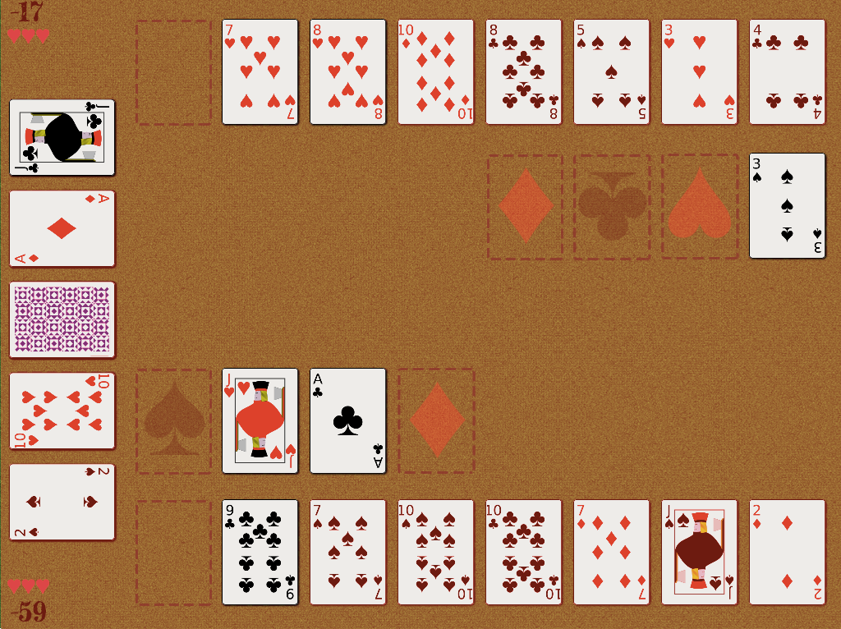
An intensity setting adds a time limit to each move.
Max Wang (u5584091)
Felicity Lee (u5558958)
Fangqin Chen (u5552738)
Notes:
Appends to AI difficulty, etc.
We decided not to use a simple numerical timer, using a fade in red effect
So that the player is more uncertain of how little time they have left.

Slide 25
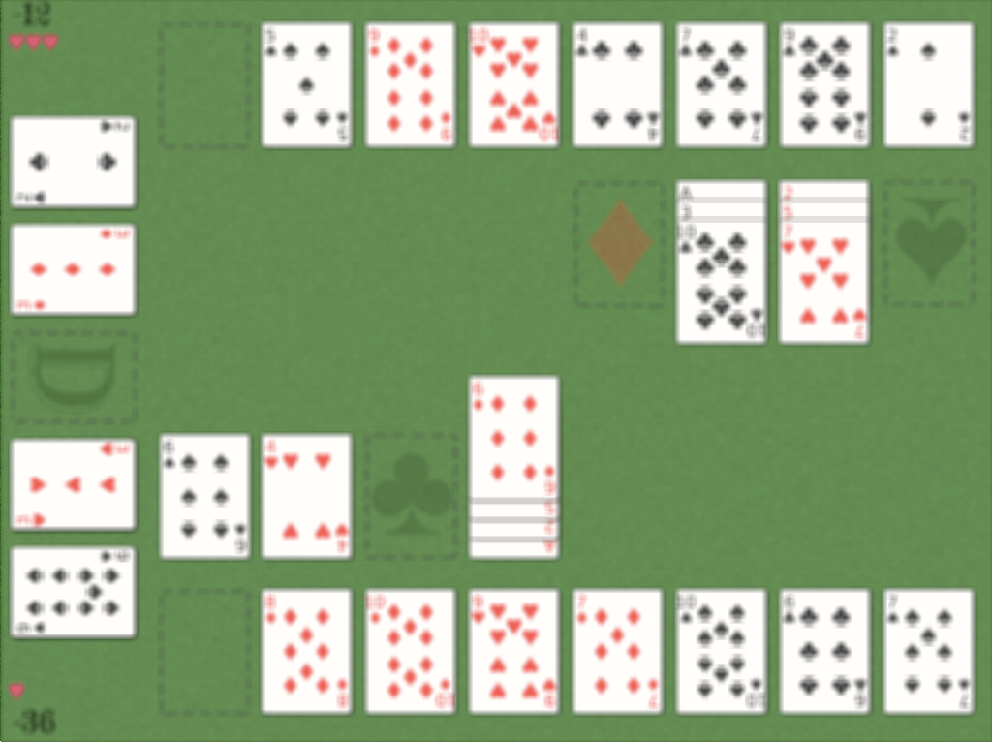
A blur effect punishes players for careless play, or taking too long to play.
Max Wang (u5584091)
Felicity Lee (u5558958)
Fangqin Chen (u5552738)
Notes:
It makes the player regret losing lives

Slide 26
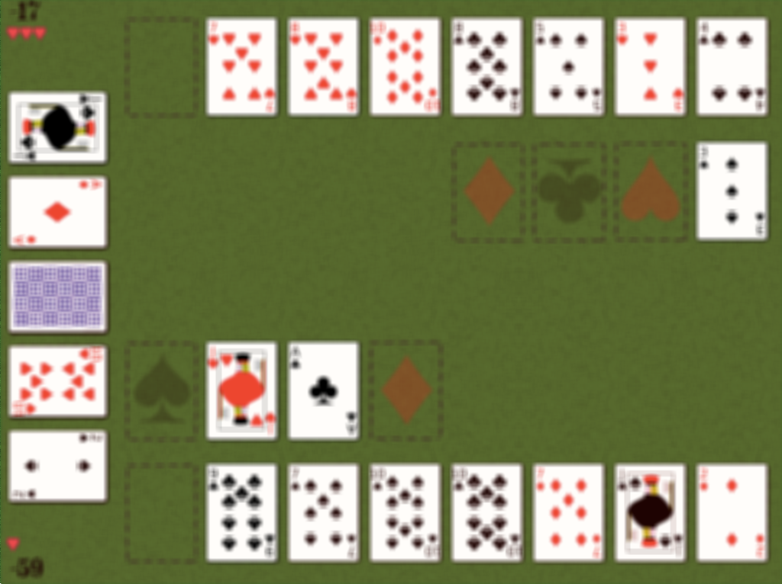
A blur effect punishes players for careless play, or taking too long to play.
Max Wang (u5584091)
Felicity Lee (u5558958)
Fangqin Chen (u5552738)
Notes:
It makes the player regret losing lives

Slide 27
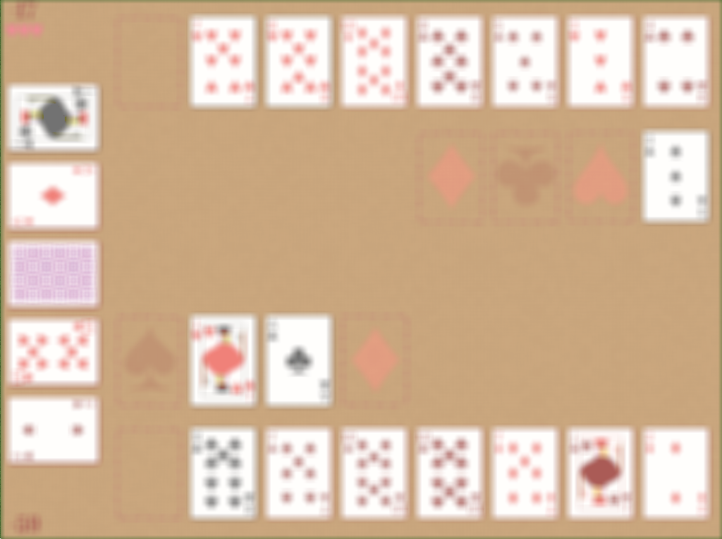
A blur effect punishes players for careless play, or taking too long to play.
Max Wang (u5584091)
Felicity Lee (u5558958)
Fangqin Chen (u5552738)
Notes:
It makes the player regret losing lives

Slide 28
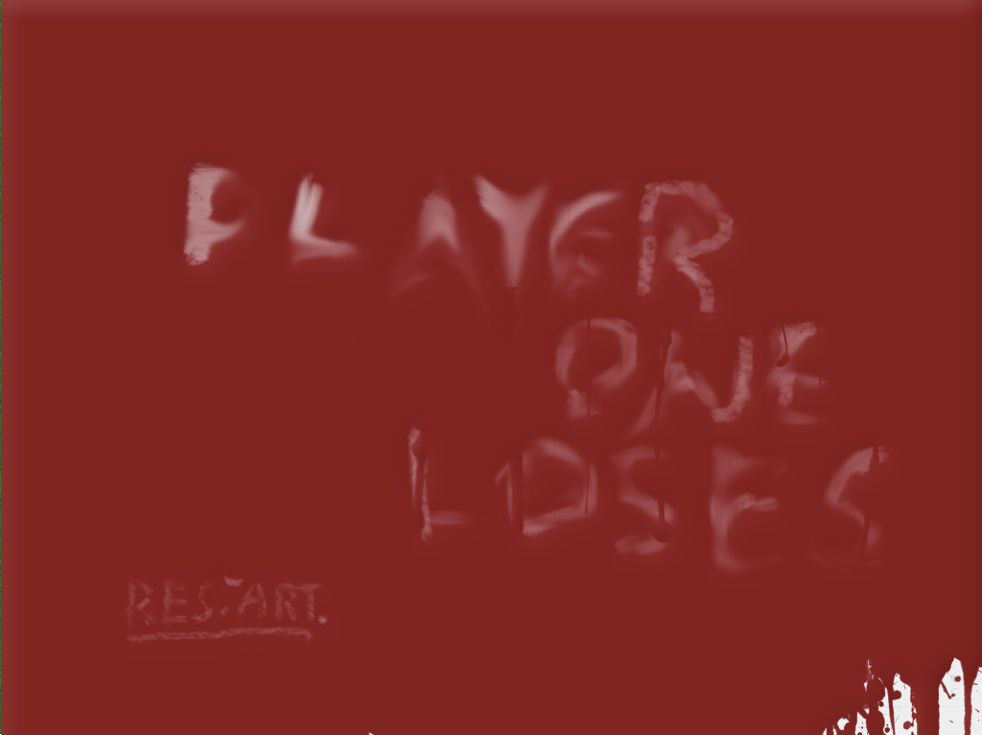
A simple end game screen only allows the player to restart, keeping them hooked.
Max Wang (u5584091)
Felicity Lee (u5558958)
Fangqin Chen (u5552738)
Notes:
It is also quite demotivational, with no win screen – instead, only saying which player loses.
Psychologically, this forces players to play more games in search of final satisfaction.

Slide 29
But enough with the Screenshots.
Let’s get on with an actual demonstration.
Max Wang (u5584091)
Felicity Lee (u5558958)
Fangqin Chen (u5552738)
Notes:
Give short demo of game.
Human vs Ai, human dies
75% AI vs 0% AI.

Slide 30
The implementation
© 2014 COMP1140 Assignment #2 Max Wang (u5584091) Felicity Lee (u5558958) Fangqin Chen (u5552738)
Notes:
After that impressive demonstration, I’m sure you’re all wondering how on earth we made such an amazing game.

Slide 31
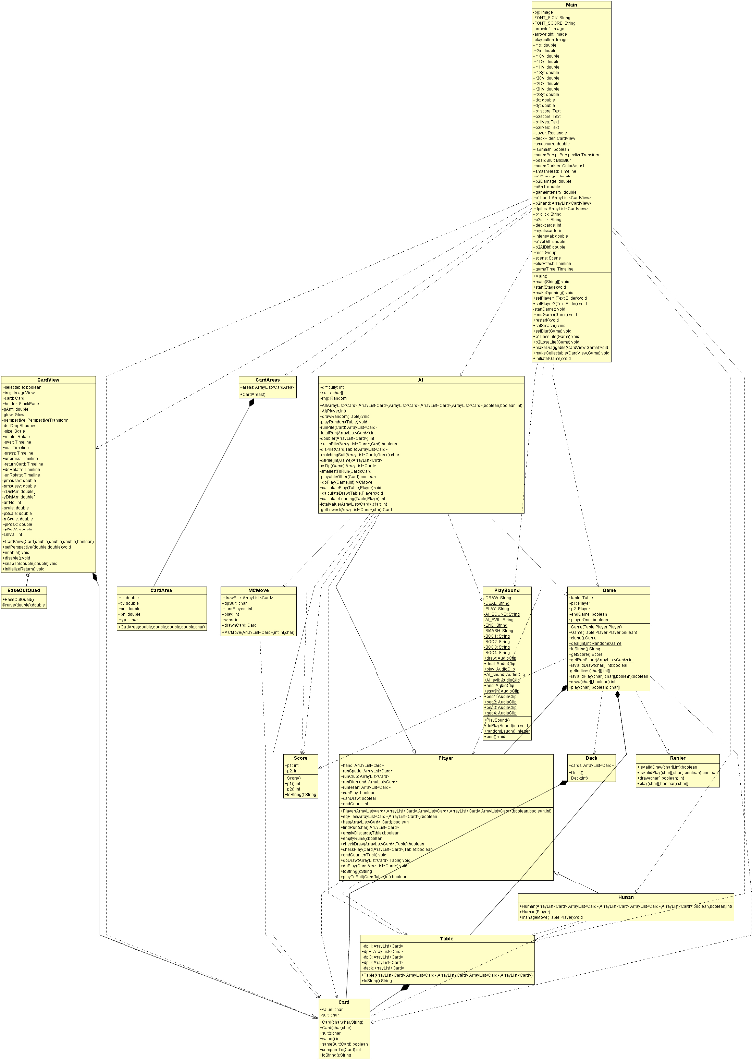
The implementation
© 2014 COMP1140 Assignment #2 Max Wang (u5584091) Felicity Lee (u5558958) Fangqin Chen (u5552738)
Notes:
After that impressive demonstration, I’m sure you’re all wondering how on earth we made such an amazing game.
We could show you the exact implementation details, but I’m sure that none of you want to know. Let us instead, just give you an overview of our project.

Slide 32
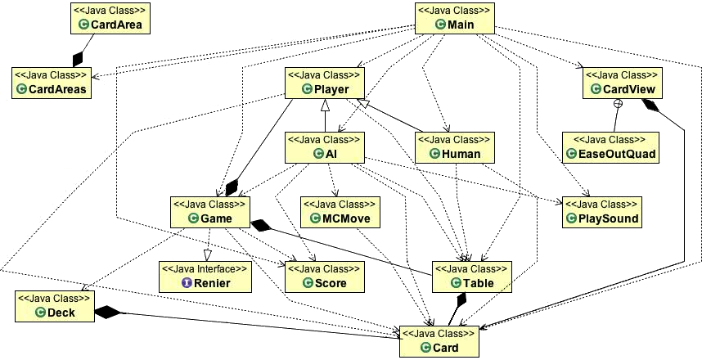
The implementation
© 2014 COMP1140 Assignment #2 Max Wang (u5584091) Felicity Lee (u5558958) Fangqin Chen (u5552738)
Notes:
After that impressive demonstration, I’m sure you’re all wondering how on earth we made such an amazing game.
We could show you the exact implementation details, but I’m sure that none of you want to know. Let us instead, just give you an overview of our project.
Explain the relation between classes, regrets, etc.
Talk about original functions.

Slide 33
Testing
JUnit tests were written for the major classes, of which reliability was critical.
© 2014 COMP1140 Assignment #2 Max Wang (u5584091) Felicity Lee (u5558958) Fangqin Chen (u5552738)
Notes:
such as for the AI, and the check/make play/draw methods.
Examples – did not want AI making illegal moves, wanted to ensure that there was no way a human would have more than 8 cards in their hand after drawing.
We played many games – especially Lynette, our main tester to ensure that everything was working as expected.

Slide 34
Testing
JUnit tests were written for the major classes, of which reliability was critical.
Some sections of the code – especially the JFX components were extremely hard to test rigorously, and had to be tested by observation.
We did, however, manage to test some key JFX components.
© 2014 COMP1140 Assignment #2 Max Wang (u5584091) Felicity Lee (u5558958) Fangqin Chen (u5552738)
Notes:
such as for the AI, and the check/make play/draw methods.
Examples – did not want AI making illegal moves, wanted to ensure that there was no way a human would have more than 8 cards in their hand after drawing.
We played many games – especially Lynette, our main tester to ensure that everything was working as expected.

Slide 35
Questions?
Max Wang (u5584091)
Felicity Lee (u5558958)
Fangqin Chen (u5552738)
Notes:
Give short demo of game.
Human vs Ai, human dies
75% AI vs 0% AI.

